Slide 1


Slide 2
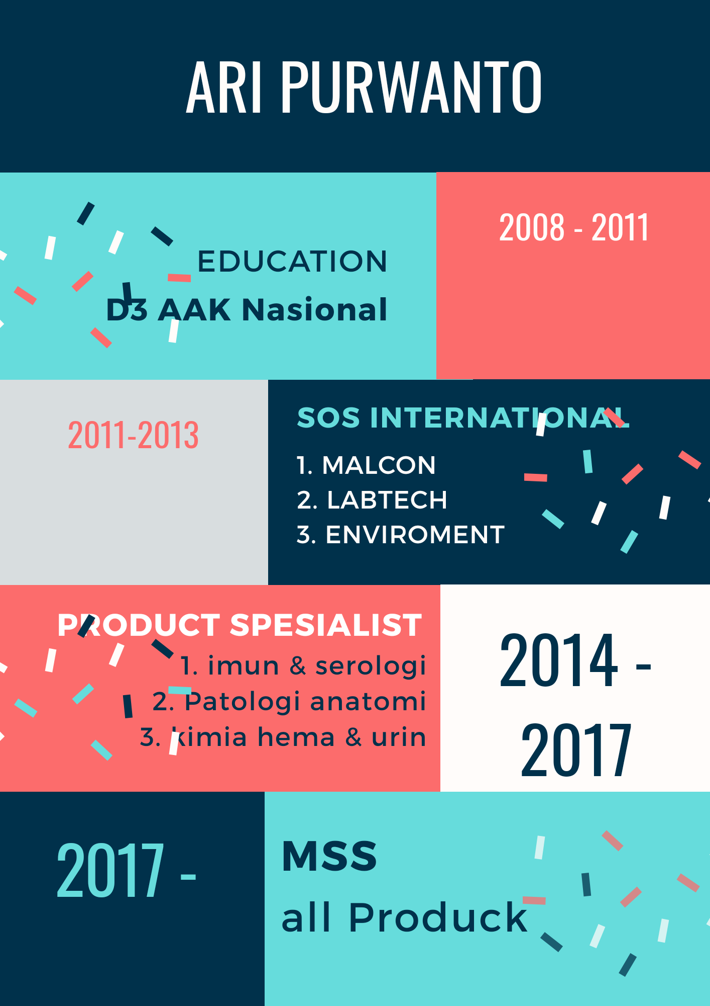

Slide 3


Slide 4

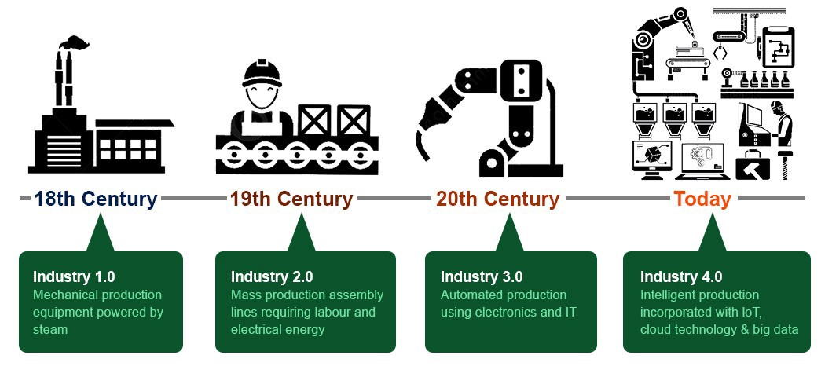
Revolusi industri 4.0

Slide 5


Slide 6
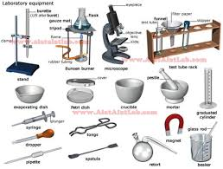
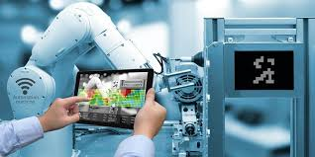
REVOLUSI LABORATORIUM

Slide 7
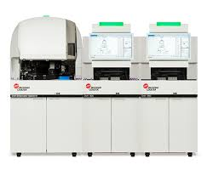
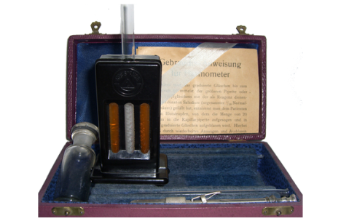
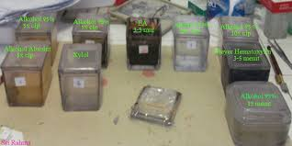
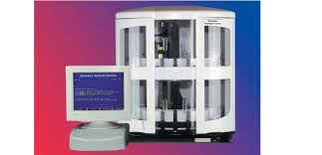
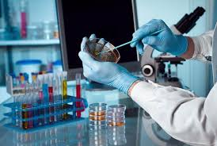
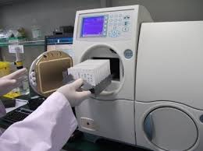
REVOLUSI DI LAB
HEMATOLOGI
Pa
mikrobiologi

Slide 8

industri
hospital
Medical device

Slide 9



SELAYANG PANDANG

Slide 10



Slide 11


Slide 12


